Slide 1
Optimization

Slide 2
Outline
The optimization problem & and usages
Finding lowest energy structure
Finding best fit
Methods for solving optimization problems
Various examples from the course
Focus on; finding lowest energy structures

Slide 3
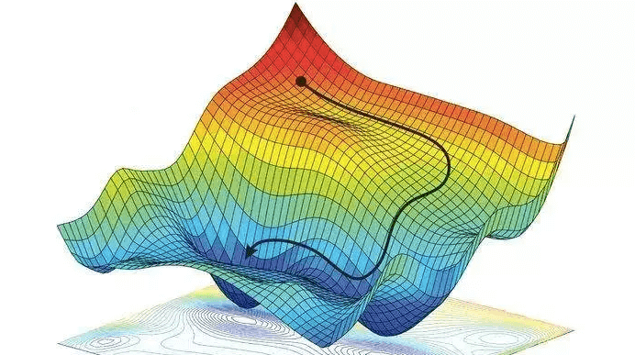
The optimization problem
Finding best solution → Minimizing some loss in terms of some paramters
Hard problem → Few cases analytic:
Doing gradient descent
Evaluation of gradient
Stuck

Slide 4
Exercises 11 – 17: Find lowest energy structures
Collection of atoms in LennardJones
First method: Metropolis Montecarlo
Temperature dependent

Slide 5
Exercises 11 – 17: Find lowest energy structures
Second method: Gradient based optimization
Line-search → Stuck
Solution: Bassin Hopping

Slide 6
Another approach: Exercise 16 – PSO
INSERT RESULT OF PARTICLE SWARM HERE

Slide 7
Another approach: Autodifferentiation

Slide 8
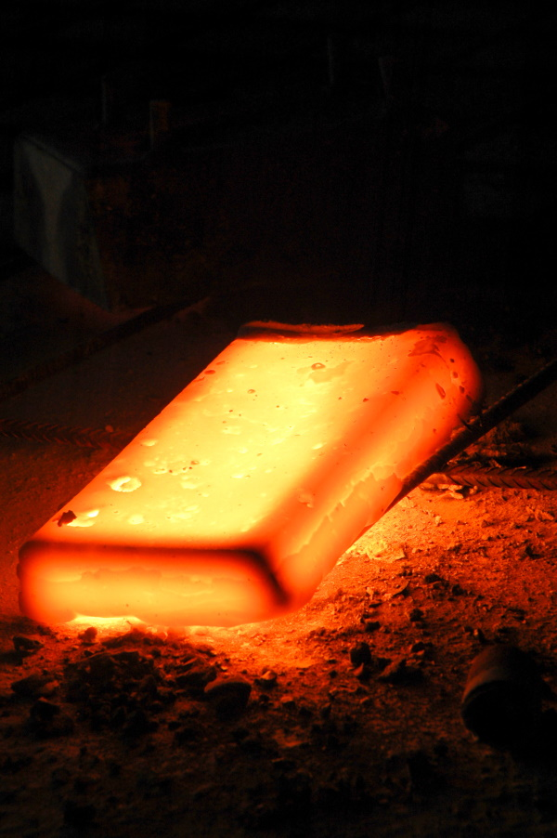
Yet another approach: Exercise 28 – Simulated annealing
Real world → Use MD-simulation
Set up relaxed atoms → Heat up → Cool down (slowly)
Hopefully end up in more stable structure

Slide 9
Yet another approach: Exercise 28 – Simulated annealing
Set up relaxed atoms → Heat up → Cool down (slowly)
Hopefully end up in more stable structure

Slide 11
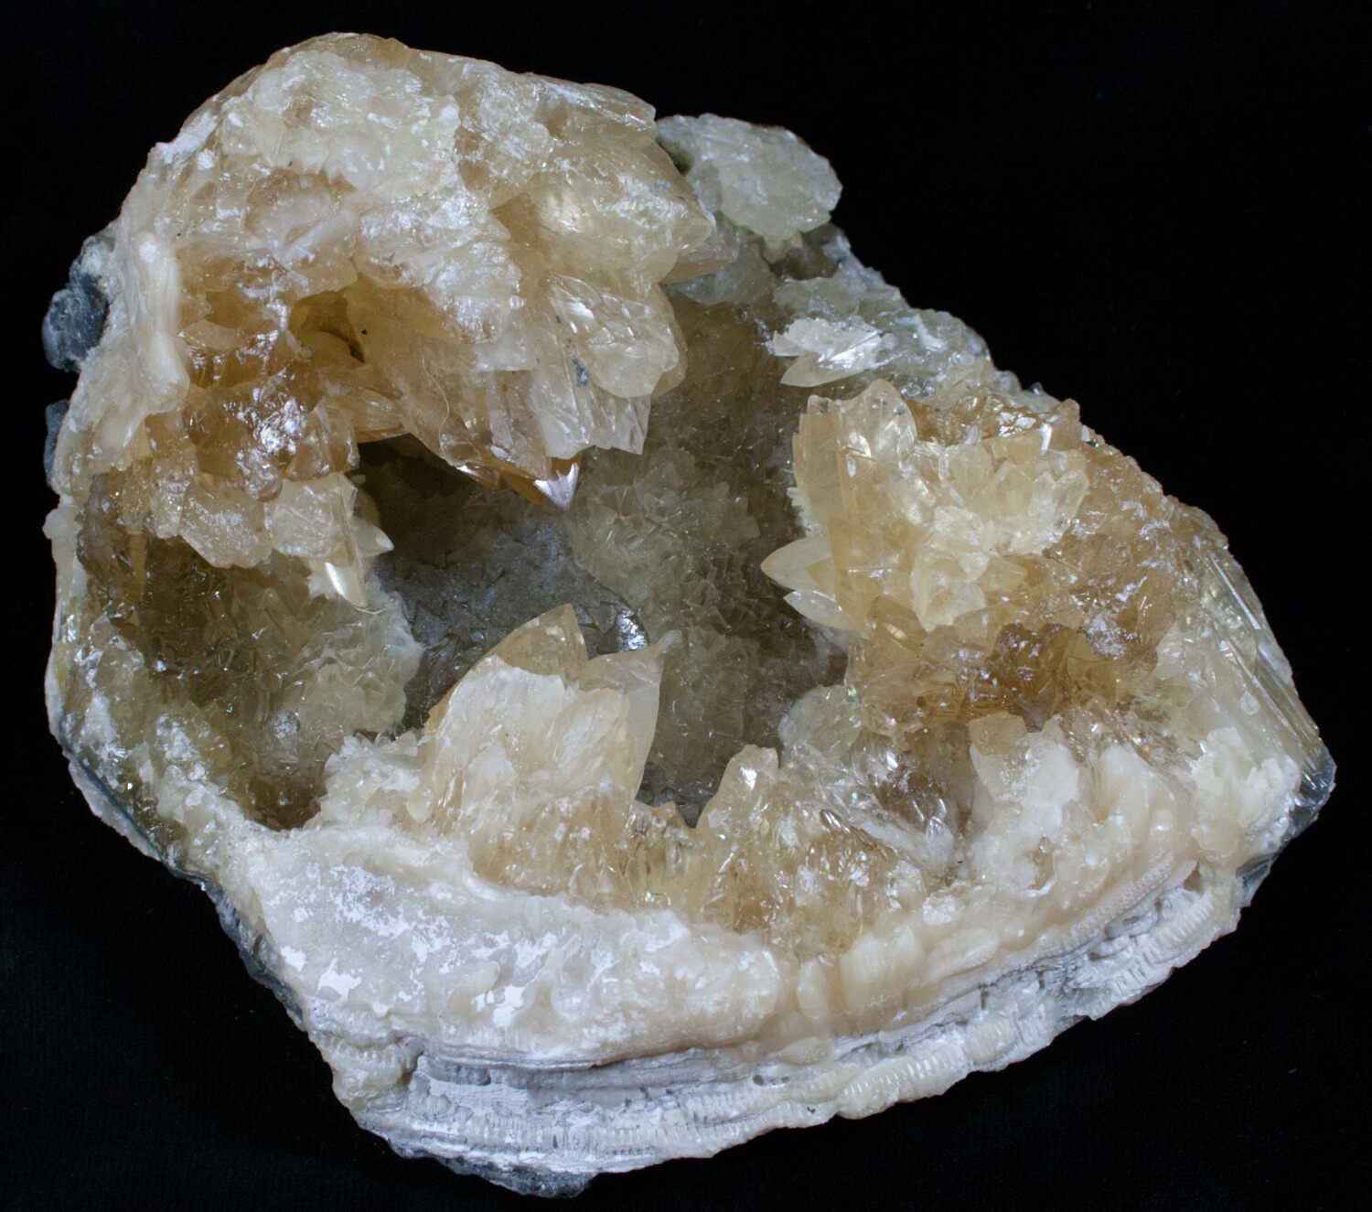
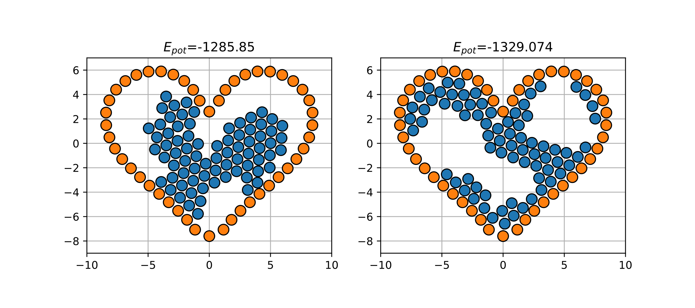
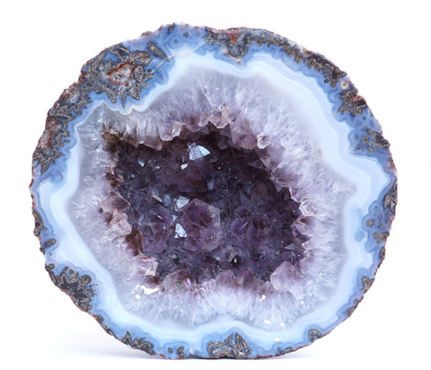
Exercise 28 – Simulated annealing
Finite simulation time

